Slide 1
Git Workflows
William Notowidado
Prepared for PT. Walden Global Services

Slide 2
Git Workflows
Centralized
Gitflow
Feature Branch
Forking

Slide 3
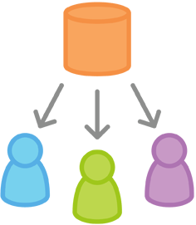
Centralized
Each developer creates a local copy of the project

Slide 4
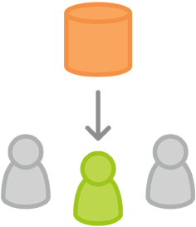
Centralized
Use --rebase when pull

Slide 5
Git Workflows
Centralized
Gitflow
Feature Branch
Forking

Slide 6
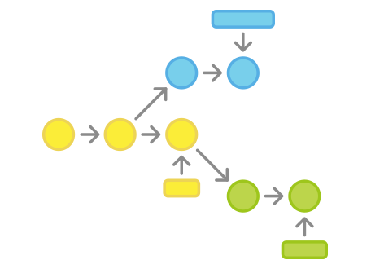
Gitflow
Strict branching model designed around the project release.

Slide 7
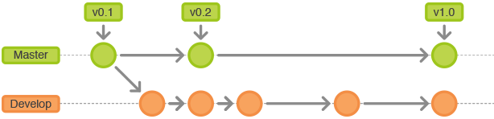
Gitflow

Slide 8
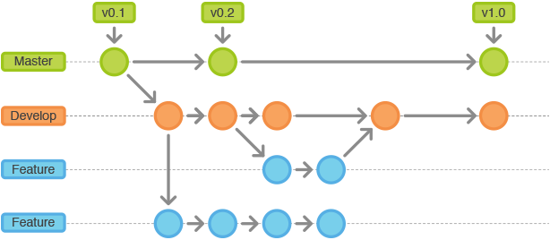
Gitflow

Slide 9
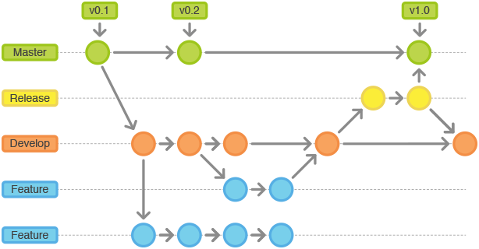
Gitflow

Slide 10
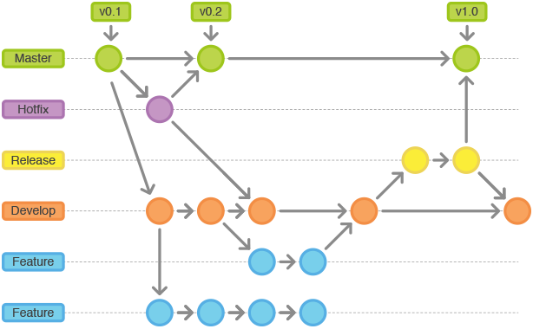
Gitflow

Slide 11
Git Workflows
Centralized
Gitflow
Feature Branch
Forking

Slide 12
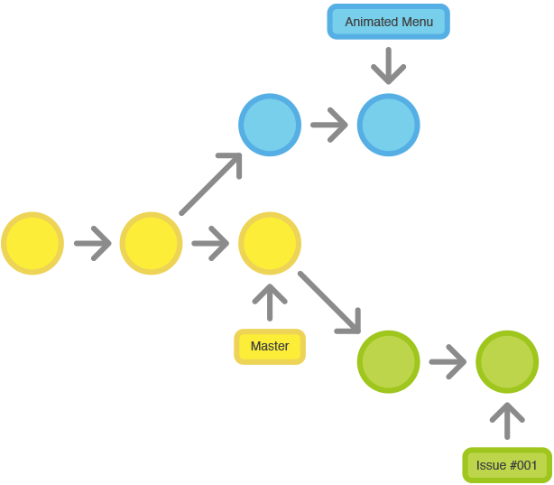
Feature Branch
Isolating feature development.

Slide 13
Git Workflows
Centralized
Gitflow
Feature Branch
Forking

Slide 14
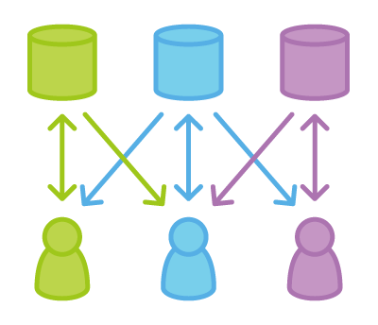
Forking
Gives developer a server-side repository.

Slide 15

Forking

Slide 16

Forking

Slide 17
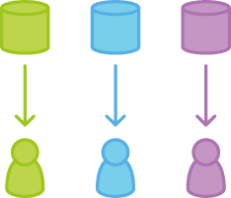
Forking

Slide 18
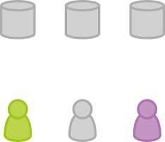
Forking

Slide 19
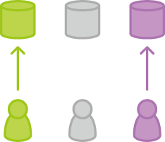
Forking

Slide 20
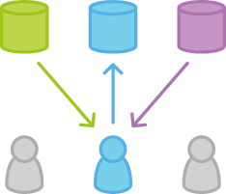
Forking

Slide 21
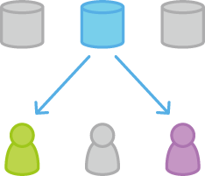
Forking

Slide 22
Git Workflows
Centralized
Gitflow
Feature Branch
Forking

